Slide 1
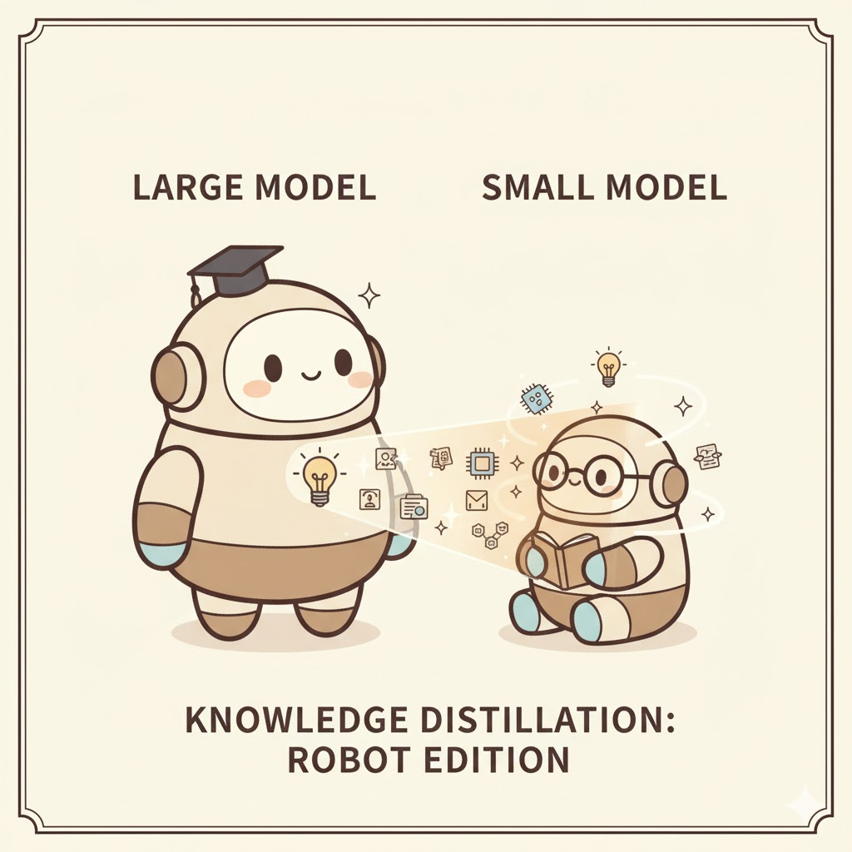
Knowledge Distillation
Bostan Khan
PhD Candidate, Mälardalen University
How to Make a Model Learn from another Model

Slide 2
Knowledge Distillation – Seminar Outline
Agenda:
Motivation
What is Knowledge Distillation?
What to Match
Self and Online Distillation
Distillation for Different Tasks
Notes:
In this seminar, we will explore both the fundamentals and the key research advances in Knowledge Distillation (KD).

Slide 3
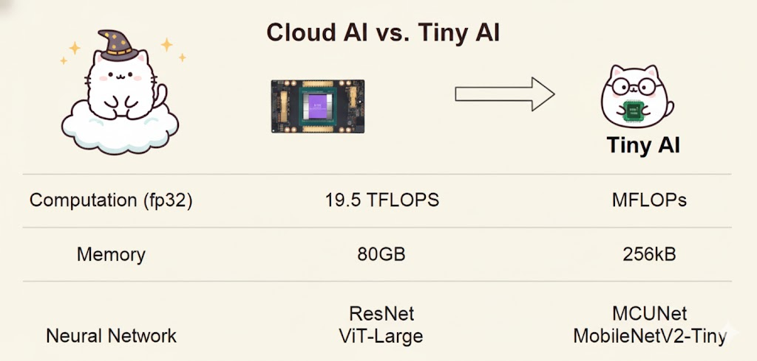
Motivation: Why Knowledge Distillation?
The Challenge: Tiny Models on Limited Hardware
Neural network must be tiny to run efficiently on tiny edge devices. How can we make this possible?
Network Augmentation for Tiny Deep Learning [Cai et al., ICLR 2022]
Source: MIT 6.5940 - TinyML and Efficient Deep Learning Computing

Slide 4
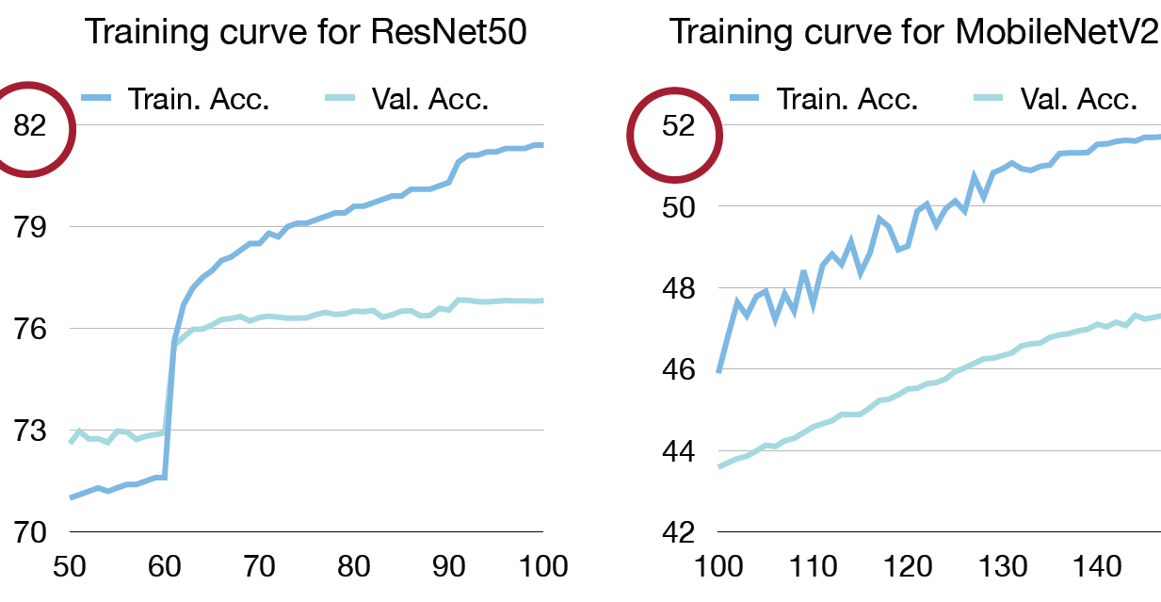
Motivation: Why Knowledge Distillation?
Tiny models are hard to train
Network Augmentation for Tiny Deep Learning [Cai et al., ICLR 2022]
Source: MIT 6.5940 - TinyML and Efficient Deep Learning Computing

Slide 5
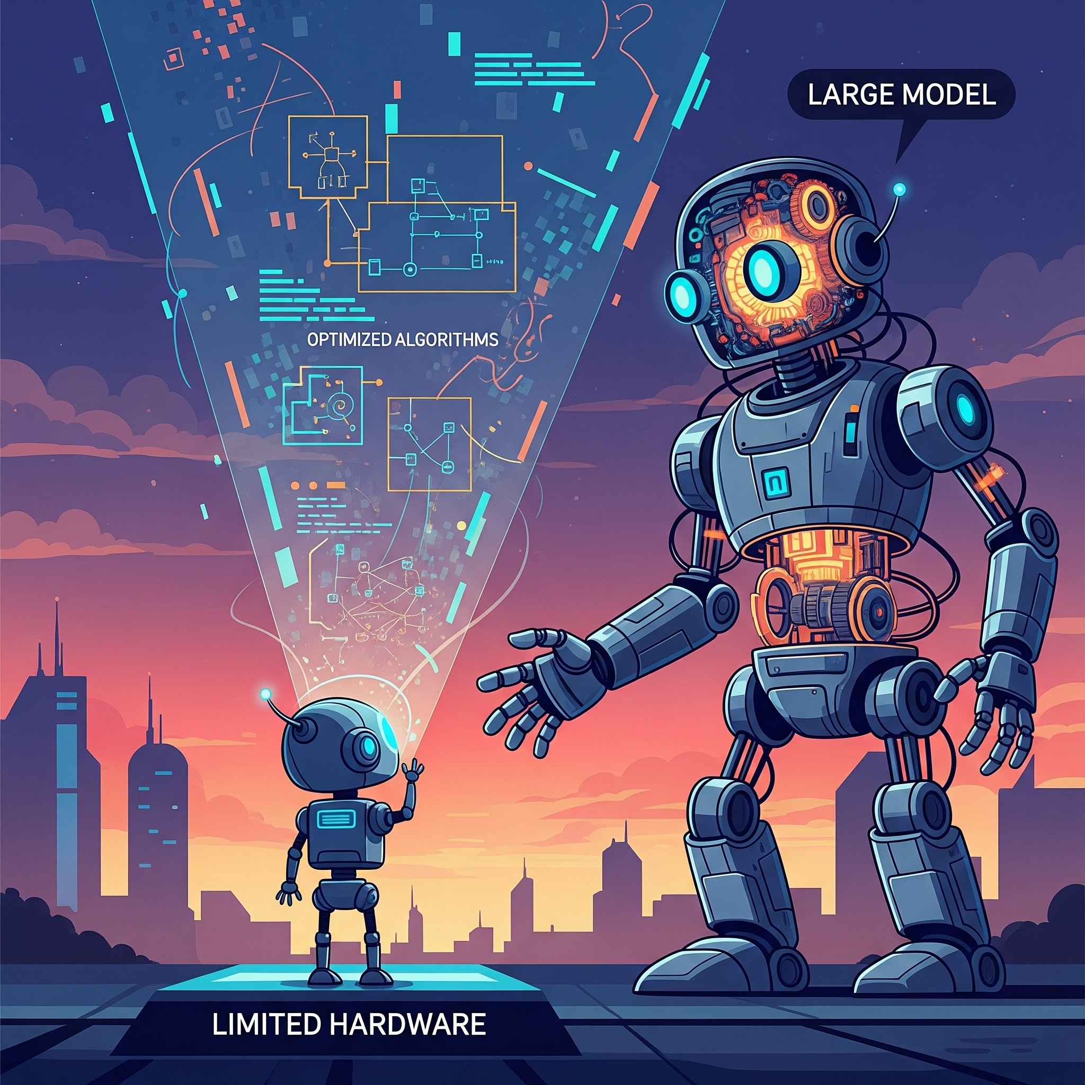
Motivation: Why Knowledge Distillation?
Question: Can we help the training of tiny models with large models?

Slide 6
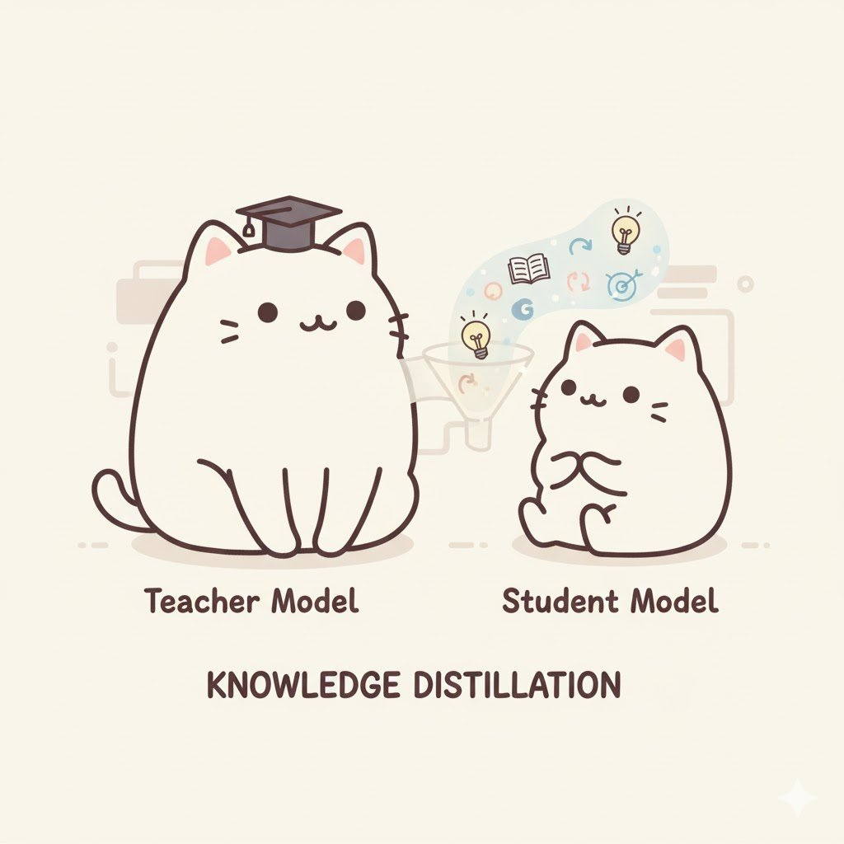
What is Knowledge Distillation?

Slide 7
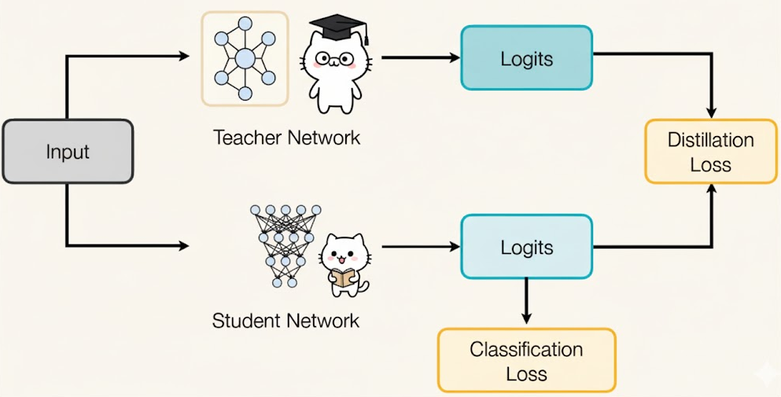
What is Knowledge Distillation?
Proposed by Hinton et al., 2015
Transfer “knowledge” from a large, accurate teacher model to a smaller, efficient student model.
Hinton, G., Vinyals, O., & Dean, J. (2015). Distilling the Knowledge in a Neural Network.
Source: MIT 6.5940 - TinyML and Efficient Deep Learning Computing

Slide 8
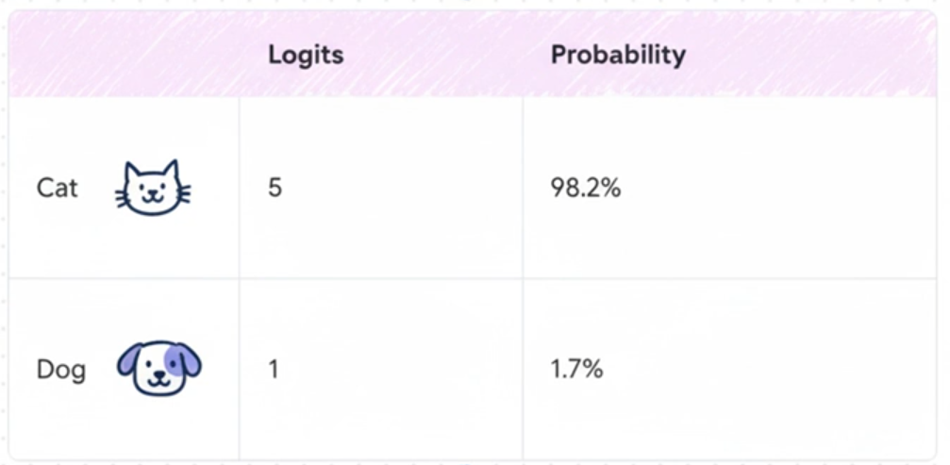
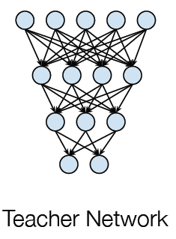

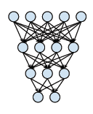
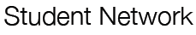
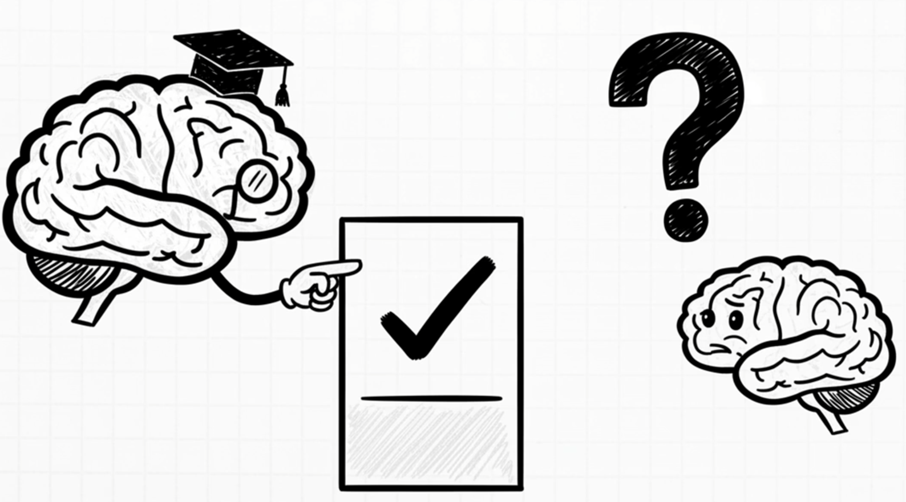
Knowledge Distillation: How it works
59.9%
40.1%
The difference between the probabilities is extreme
Its like telling a student just an answer and not explaining why!
Solution: Soften the probabilities

Slide 9
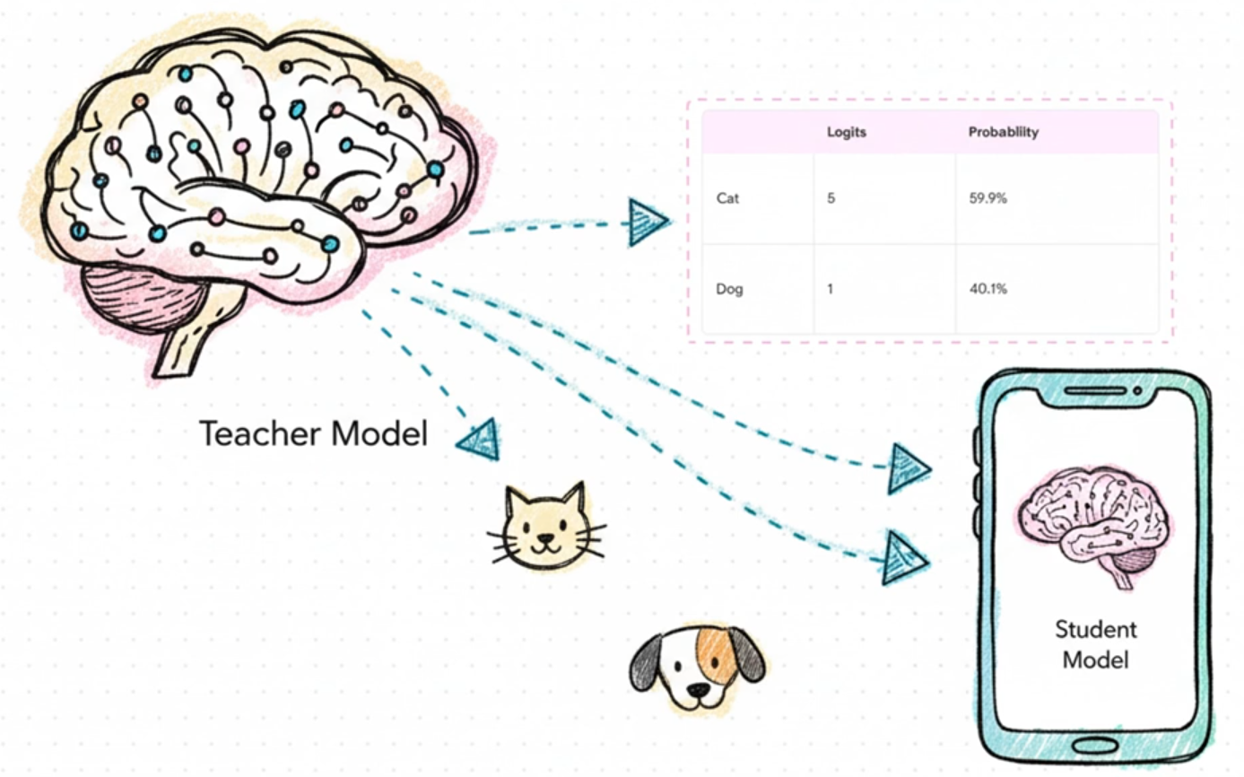
Knowledge Distillation: How it works
Why Soften the Logit Probabilities?
Dark Knowledge
Hidden in probability distributions of large models
Subtle relationships between classes, like what is similar between cats and dogs and what is not!
In other words
KD transfers this “Dark Knowledge” from big, complex models to smaller, compact ones without significant performance loss
Notes:
It’s like a teacher explaining why an answer is correct instead of just giving the answer — the student learns relationships between classes, not just labels.

Slide 10
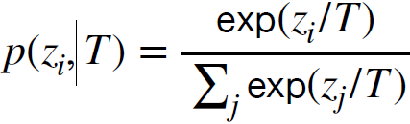
Knowledge Distillation
How to Soften the Logit Probabilities?
Formal Definition of KD
Neural networks typically use a softmax function to generate the logits to class probabilities
Here, i, j = 0,1,2,...,C − 1, where C is the number of classes. T is the temperature, which is normally set to 1.
The goal of knowledge distillation is to align the class probability distributions from teacher and student networks.
Source: MIT 6.5940 - TinyML and Efficient Deep Learning Computing

Slide 11
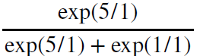
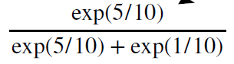
Knowledge Distillation
How to Soften the Logit Probabilities?
We use temperature T for softening the softmax probabilities
(T=1)
(T=10)
59.9
40.1

Slide 12
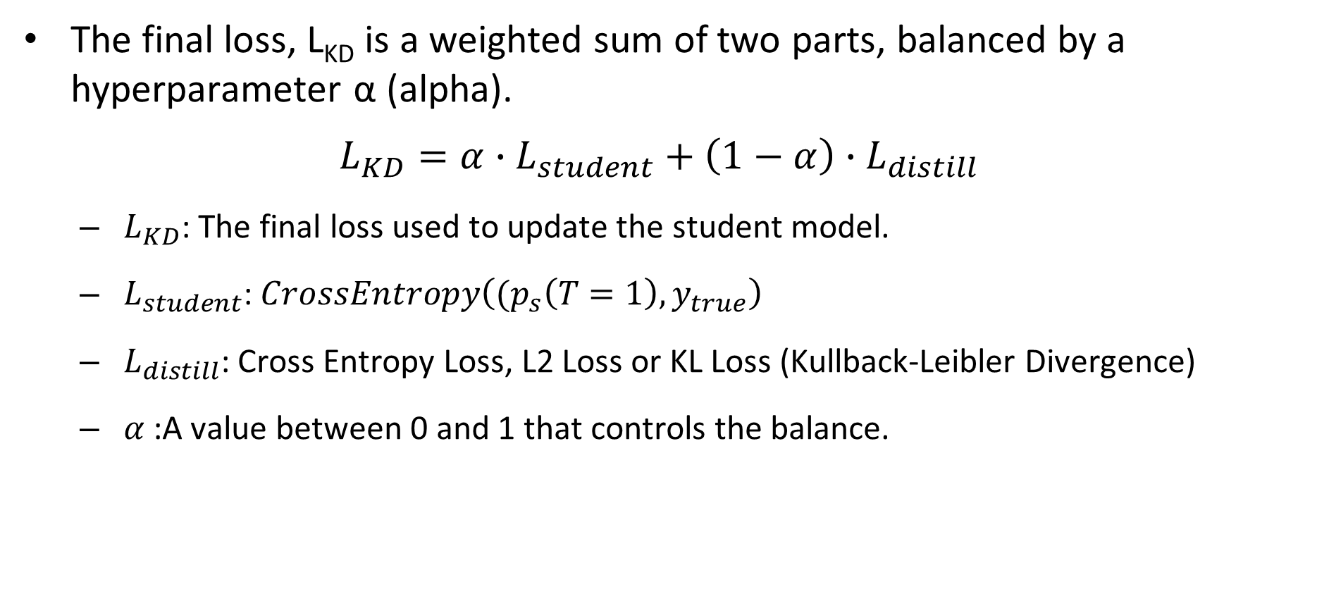
Knowledge Distillation
The final loss, L_{KD} is a weighted sum of two parts, balanced by a hyperparameter α (alpha).
$$L_{KD}=α∙L_{student}+\left(1−α\right)∙L_{distill}$$
$L_{KD}$: The final loss used to update the student model.
$L_{student}$: $CrossEntropy\left((p_{s}\left(T=1\right),y_{true}\right)$
$L_{distill}$: Cross Entropy Loss, L2 Loss or KL Loss (Kullback-Leibler Divergence)
$α$:A value between 0 and 1 that controls the balance.

Slide 13
What to Match in Knowledge Distillation?

Slide 14
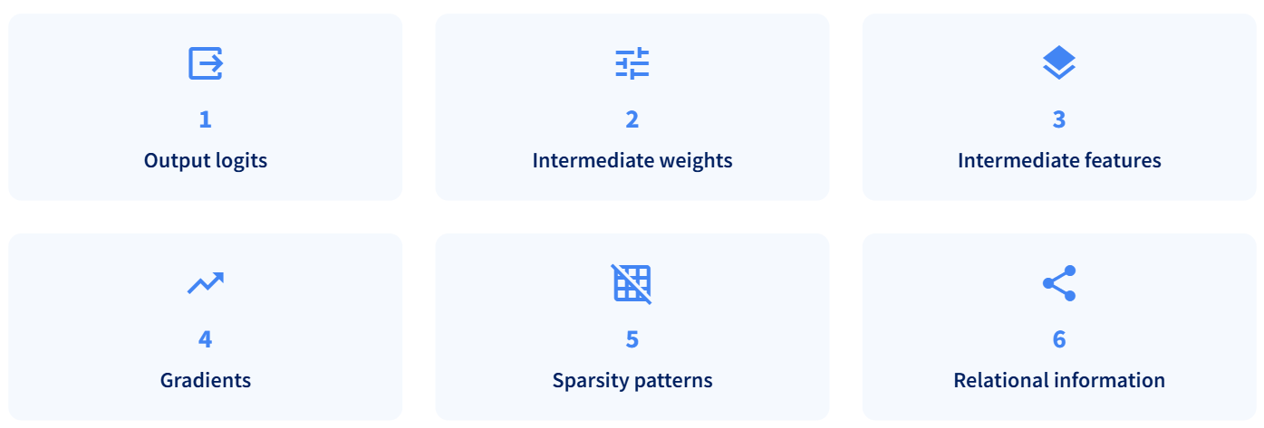
What to Match in KD
Other than logits, what elements can we match between teacher and student models?

Slide 15
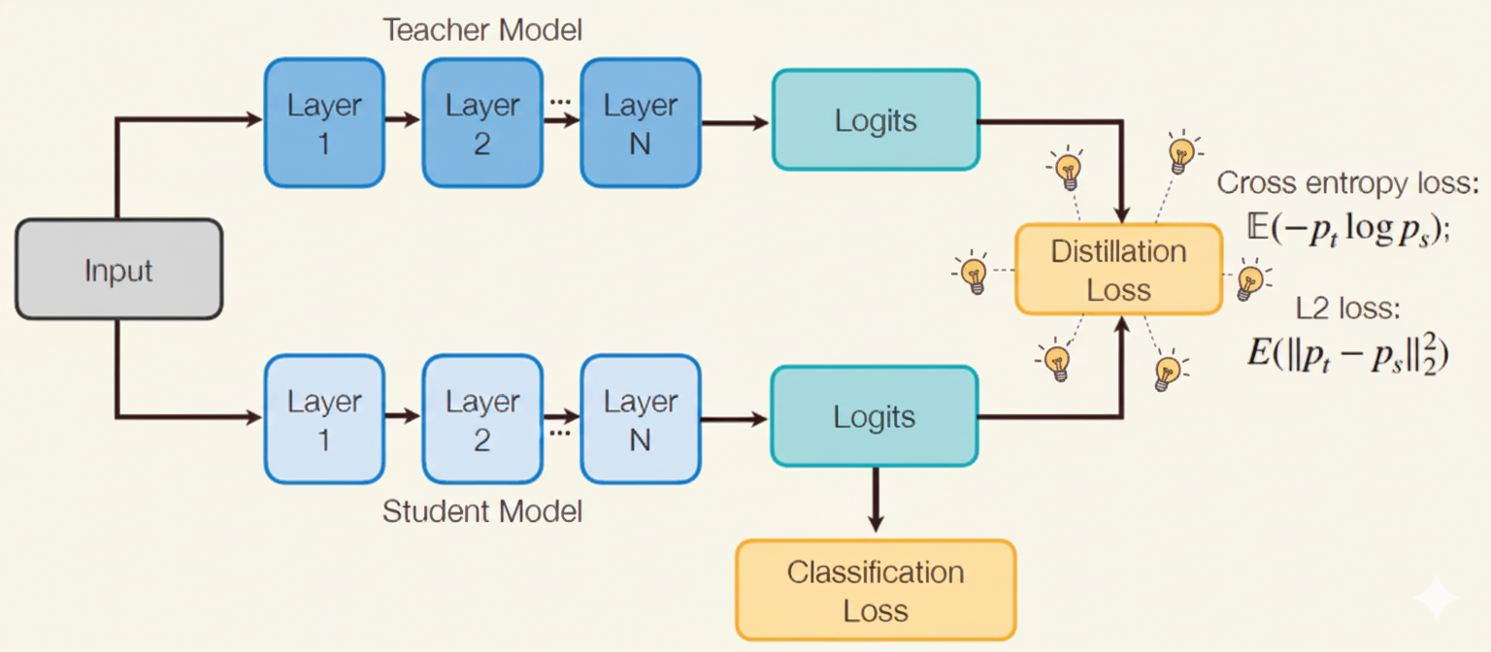
What to Match in KD
1. Matching output logits
Source: MIT 6.5940 - TinyML and Efficient Deep Learning Computing

Slide 16
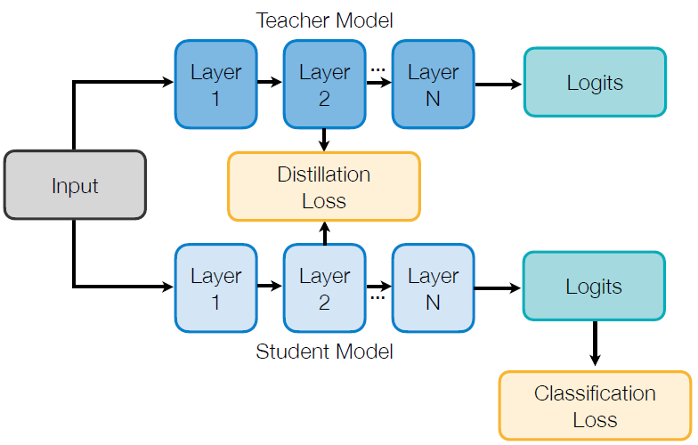
What to Match in KD
2. Matching intermediate weights
Source: MIT 6.5940 - TinyML and Efficient Deep Learning Computing

Slide 17
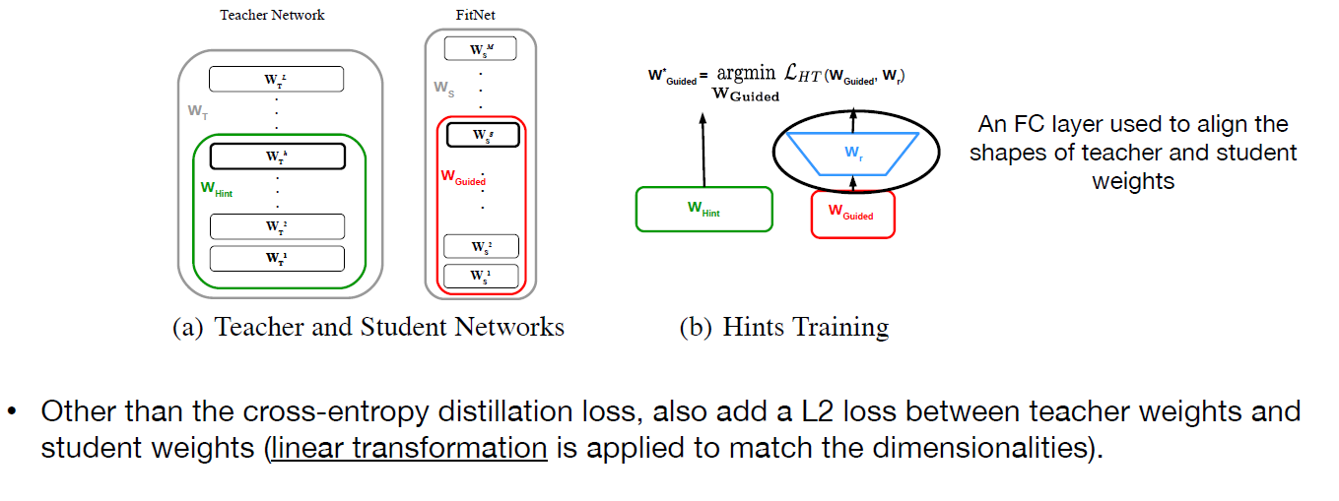
What to Match in KD
2. Matching intermediate weights
FitNets: Hints for Thin Deep Nets [Romero et al., ICLR 2015]
Source: MIT 6.5940 - TinyML and Efficient Deep Learning Computing

Slide 18
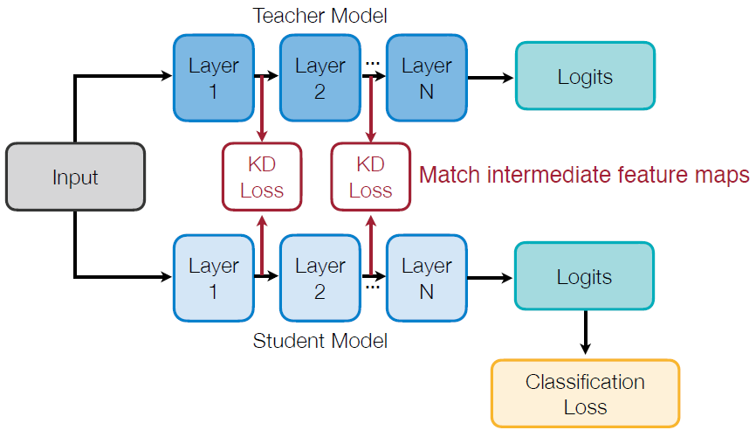
What to Match in KD
3. Matching intermediate features
Intuition: teacher and student networks should have similar feature distributions, not just output probability distributions.
By minimizing maximum mean discrepancy between feature maps
Like What You Like: Knowledge Distill via Neuron Selectivity Transfer [Huang and Wang, arXiv 2017]
Source: MIT 6.5940 - TinyML and Efficient Deep Learning Computing

Slide 19
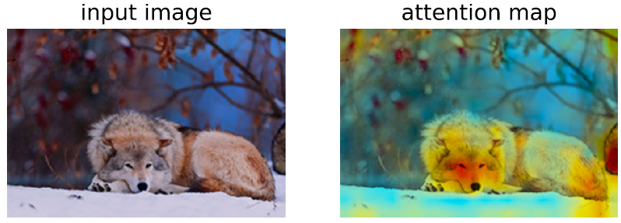
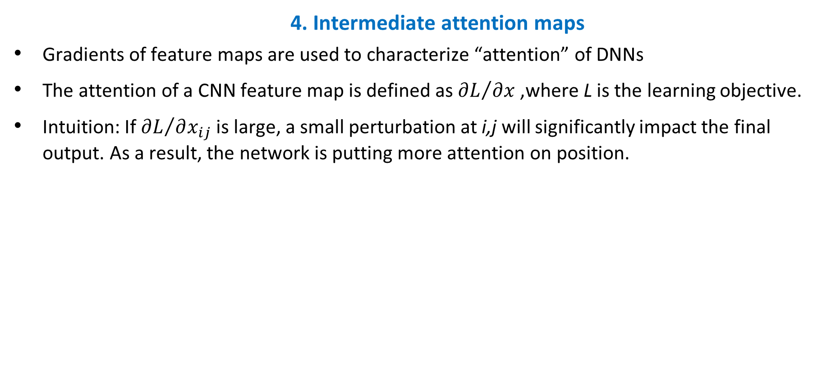
What to Match in KD
4. Intermediate attention maps
Gradients of feature maps are used to characterize “attention” of DNNs
The attention of a CNN feature map is defined as ${∂L}/{∂x}$, where L is the learning objective.
Intuition: If ${∂L}/{∂x_{ij}}$ is large, a small perturbation at i,j will significantly impact the final output. As a result, the network is putting more attention on position.
Paying More Attention to Attention: Improving the Performance of Convolutional Neural Networks via Attention Transfer [Zagoruyko and Komodakis, ICLR 2017]
Source: MIT 6.5940 - TinyML and Efficient Deep Learning Computing

Slide 20
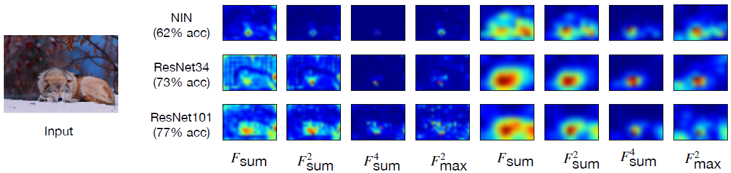
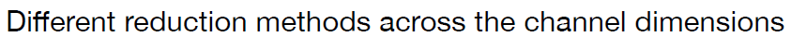
What to Match in KD
4. Intermediate attention maps
Performant models have similar attention maps
Attention maps of performant ImageNet models (ResNets) are indeed similar to each other, but the less performant model (NIN) has quite different attention maps.
Paying More Attention to Attention: Improving the Performance of Convolutional Neural Networks via Attention Transfer [Zagoruyko and Komodakis, ICLR 2017]
Source: MIT 6.5940 - TinyML and Efficient Deep Learning Computing

Slide 21
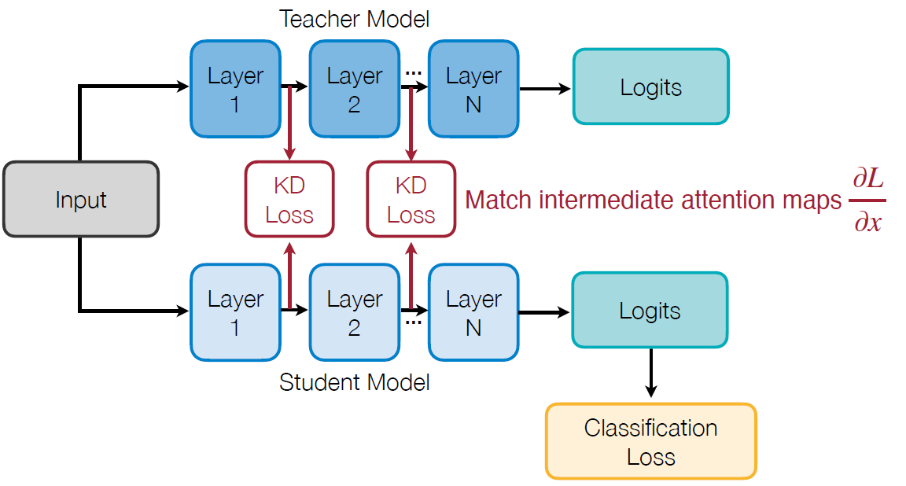
What to Match in KD
4. Intermediate attention maps
Paying More Attention to Attention: Improving the Performance of Convolutional Neural Networks via Attention Transfer [Zagoruyko and Komodakis, ICLR 2017]
Source: MIT 6.5940 - TinyML and Efficient Deep Learning Computing

Slide 22
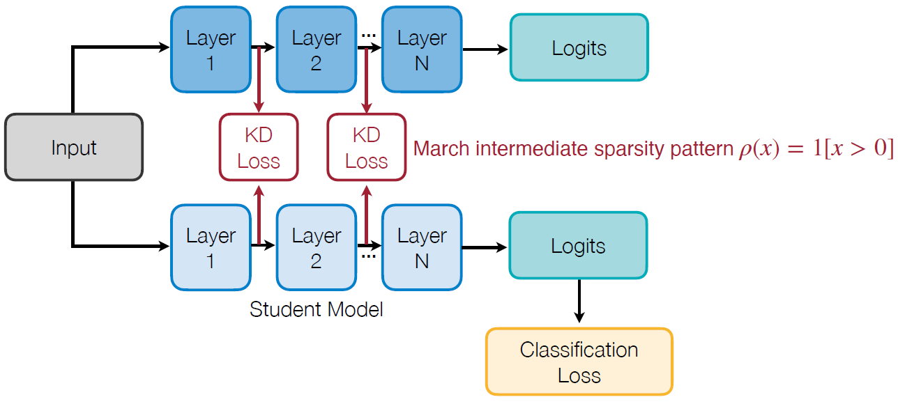
What to Match in KD
5. Matching sparsity patterns
Intuition: the teacher and student networks should have similar sparsity patterns after the ReLU activation. A neuron is activated after ReLU if its value is larger than 0, denoted by the indicator function ρ(x) = 1[x > 0] .
Knowledge Transfer via Distillation of Activation Boundaries Formed by Hidden Neurons [Heo et al., AAAI 2019]
Source: MIT 6.5940 - TinyML and Efficient Deep Learning Computing

Slide 23
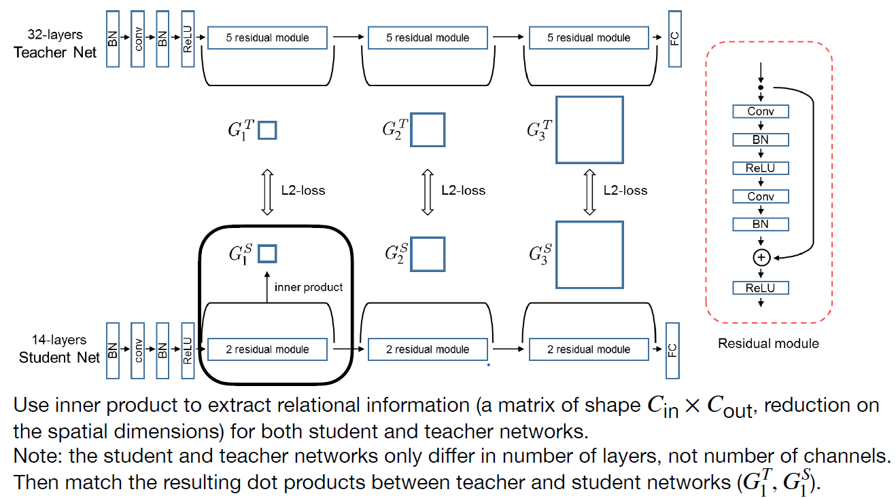
What to Match in KD
6. Matching relational information
Relations between different layers
A Gift from Knowledge Distillation: Fast Optimization, Network Minimization and Transfer Learning [Yim et al., CVPR 2017]
Source: MIT 6.5940 - TinyML and Efficient Deep Learning Computing

Slide 24
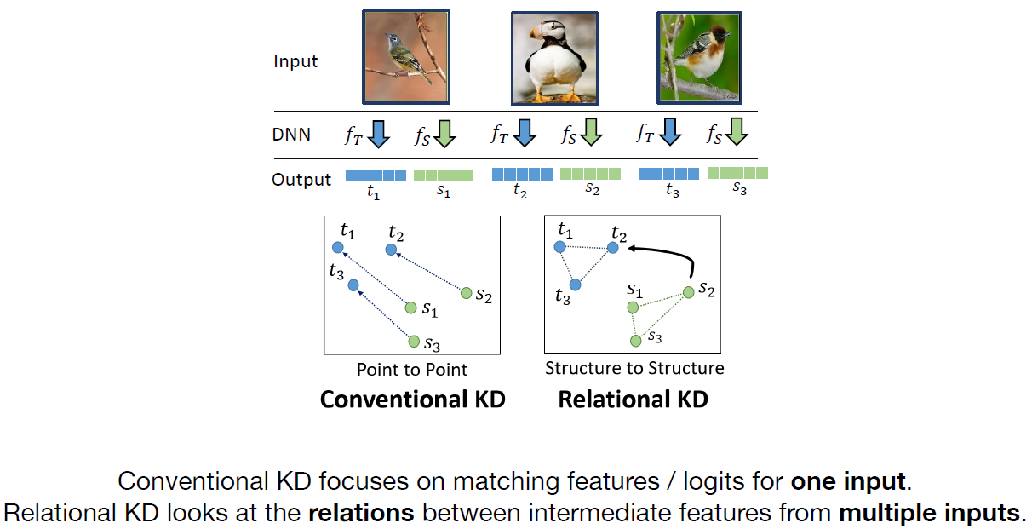
What to Match in KD
6. Matching relational information
Relations between different samples
A Gift from Knowledge Distillation: Fast Optimization, Network Minimization and Transfer Learning [Yim et al., CVPR 2017]
Source: MIT 6.5940 - TinyML and Efficient Deep Learning Computing

Slide 25
Common Loss Functions for Matching in KD
The choice of loss function depends on what you are trying to match (logits, features, or relations).

Slide 26
Loss Functions for Matching
1. KL Divergence
What it's for: This is the standard "Soft Loss" for matching the final output distributions.
How it works: It measures the difference between the teacher's soft probabilities and the student's soft probabilities.
Goal: To make the student's probability distribution mimic the teacher's.

Slide 27
Loss Functions for Matching
2. L2 Loss (Mean Squared Error - MSE)
What it's for: A flexible loss used to directly match the values of intermediate layers.
Common uses:
Matching intermediate features or feature maps.
Matching intermediate weights (often after a transformation).
Matching relational information between layers.
It can also be used as an alternative to KL Divergence for matching the final logits directly.

Slide 28
Loss Functions for Matching
3. Cross-Entropy
What it's for: This loss has two key roles in KD.
Role 1 (Hard Loss): It's the standard Classification Loss used to train the student on the true, ground-truth labels.
Role 2 (Soft Loss): It can also be used as the distillation loss, where the teacher's soft probabilities are treated as "labels" for the student.

Slide 29
Distillation Training Schemes
Let’s see how teacher and student are trained together.

Slide 30
Distillation Training Schemes
KD is also classified by how the teacher and student models are trained and updated.
Offline Distillation (Traditional KD)
Self-Distillation
Online Distillation
Combined Techniques

Slide 31
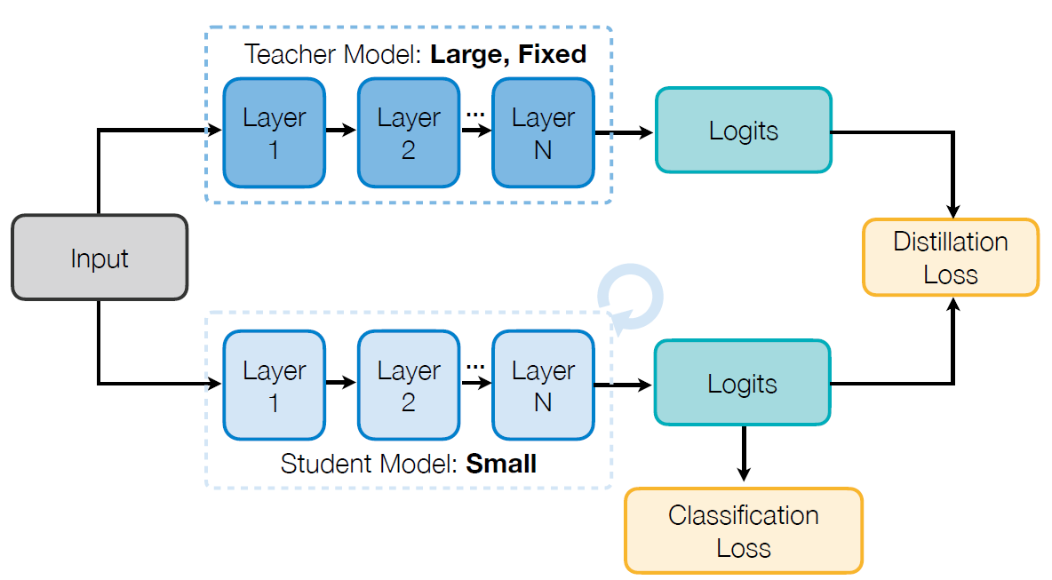
Distillation Training Schemes
1. Offline Distillation (Traditional KD)
Teacher model is usually larger than the student model and is fixed
What is the disadvantage of fixed large teachers?
Does it have to be the case that we need a fixed large teacher in KD?
Source: MIT 6.5940 - TinyML and Efficient Deep Learning Computing

Slide 32
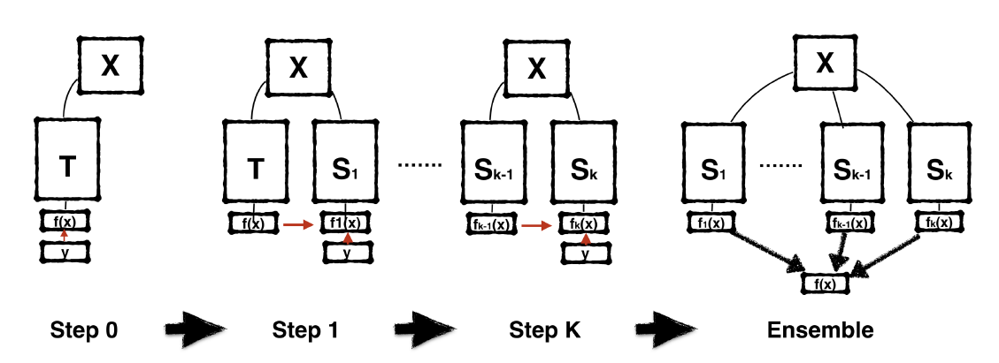
Distillation Training Schemes
2. Self-Distillation
All models (teacher and student) share the same architecture and size (e.g., T=S₁=S₂=...).
Network architecture T=S₁=S₂=... = S_{k}
Network accuracy T < S₁< S₂ < … < S_{k}
Can alternatively ensemble T, S₁, S₂, …, S_{k} to get even better performance.
Born-Again Neural Networks [Furlanello et al., ICML 2018]
Source: MIT 6.5940 - TinyML and Efficient Deep Learning Computing

Slide 33
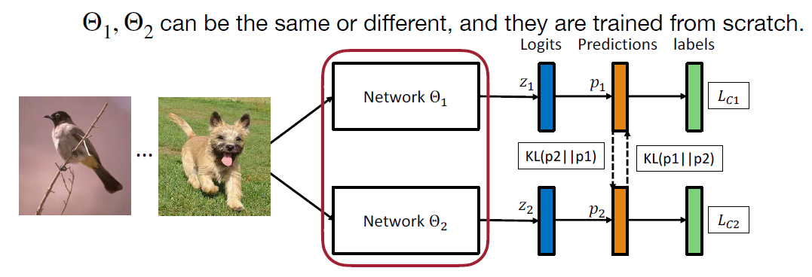
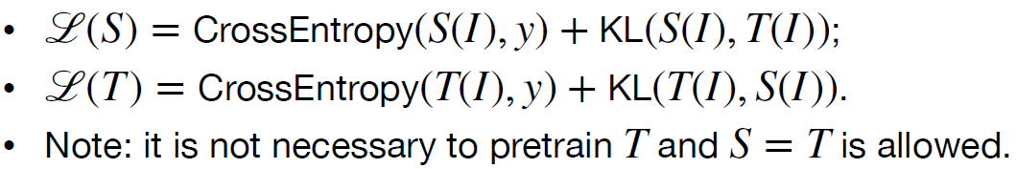
Distillation Training Schemes
3. Online Distillation
Multiple models (Teacher and Student, or multiple peers) are trained simultaneously and updated in the same process.
The models mutually learn from each other's output distributions.
Source: MIT 6.5940 - TinyML and Efficient Deep Learning Computing

Slide 34
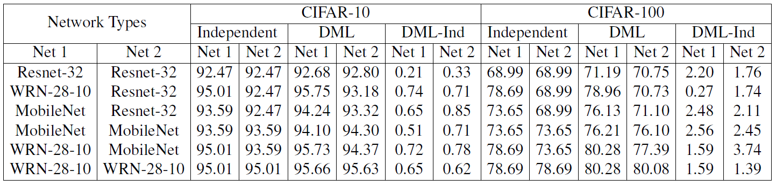
Distillation Training Schemes
3. Online Distillation
Deep mutual learning can improve both student (net 2) and teacher (net 1) models.
Source: MIT 6.5940 - TinyML and Efficient Deep Learning Computing

Slide 35
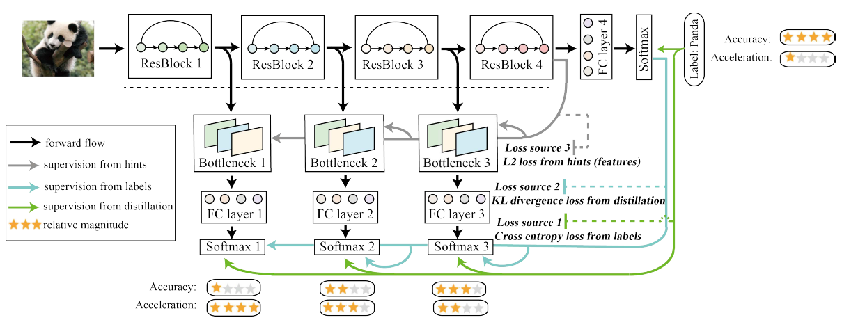
Distillation Training Schemes
4. Combined Techniques
Combining Online and Self-Distillation
"Be Your Own Teacher" combines Self-Distillation (deep supervision) with Feature-Based KD, using deeper layers to supervise predictions from earlier stages.
Be Your Own Teacher: Improve the Performance of Convolutional Neural Networks via Self Distillation [Zhang et al., ICCV 2019]
Source: MIT 6.5940 - TinyML and Efficient Deep Learning Computing

Slide 36
Distillation for Different Tasks

Slide 37
Distillation for Different Tasks
KD extends beyond standard classification:
Object Detection: Distill both classification (soft targets with weighting) and regression (L2/bounded loss).
Semantic Segmentation: Distill features, use pixel-wise loss, and often incorporate adversarial methods (discriminator net).
GANs: Compress the Generator model. Achieves extreme efficiency (e.g., 16x FLOPs reduction) using distillation, reconstruction, and adversarial losses.
NLP/LLMs: Key for creating compact models (like MobileBERT). Transfers attention maps and intermediate feature maps from Transformer layers.

Slide 38
Acknowledgments
Some content, figures, and ideas in this presentation were adapted from:
MIT 6.5940 – TinyML and Efficient Deep Learning Computing
Instructor: Prof. Song Han, MIT
Used here for educational and non-commercial purposes as part of a seminar presentation.

Slide 39
Thank you!

